Slide 1
HCI CA 1: User Research
Rahul, Prabhjeet Bissora, Paulina Czarnota

Slide 2

Dailymail.co.uk
A British daily tabloid newspaper published in 1896.
Known for its coverage of celebrity news, human-interest stories, and political news.
Has a large online presence through its website, dailymail.co.uk.
Covers a wide range of topics, including news, entertainment, sports, health, science, and technology.
Often criticized for being sensationalistic and controversial, with accusations of publishing clickbait headlines and inaccurate stories.

Slide 3
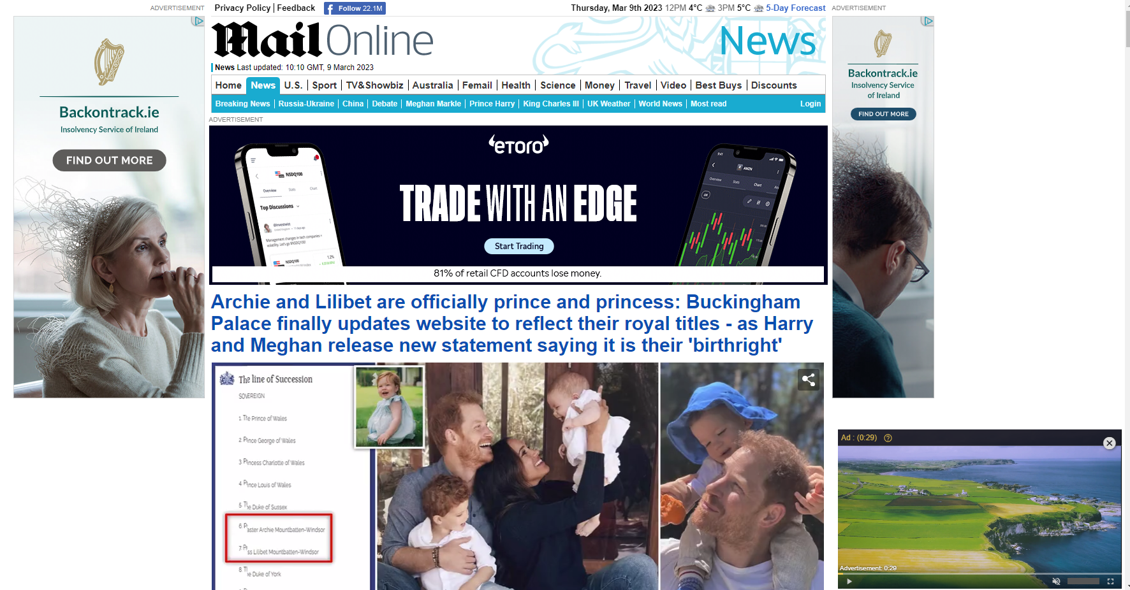
Problems
Overwhelming Amount of Content
Intrusive Ads
Poor Readability
Limited Customization Options
Bias and Credibility Concerns
Lots of White Space on Sides
Notes:
●Overwhelming amount of content: particularly for those who are looking for specific topics.
●Intrusive ads: has a lot of ads And can be intrusive and disruptive to the user experience.
●Poor readability: The website uses a small font size and a cluttered layout.
●Limited customization options: Limited customization options for users to adjust the layout, font size, or color scheme.
●Bias and credibility concerns: The Daily Mail is known for its conservative editorial stance and has been criticized for publishing inaccurate or misleading stories.

Slide 4
Desk Research
The Daily Mail website (dailymail.co.uk) is a public website that is accessible to anyone with an internet connection.
Majority of its users are from the UK, with significant numbers of users from the United States and Australia.
The Daily Mail's audience is generally older, with users aged 45 and above being the largest demographic.
The website's audience is predominantly female.
The Daily Mail's audience is more likely to have conservative-leaning and right-wing political views.

Slide 5

User Research
Our group conducted both qualitative and quantitative user research on dailymail.co.uk.
We used online surveys, in-person interviews, and usability tests to gather data on users' experience, preferences, and pain points.
We asked about their goals, tasks, motivations, and emotions when using the website.
We also conducted desk research to analyze existing literature, reviews, and feedback on the website's usability and user experience.
User opinions about dailymail.co.uk are divided.

Slide 6
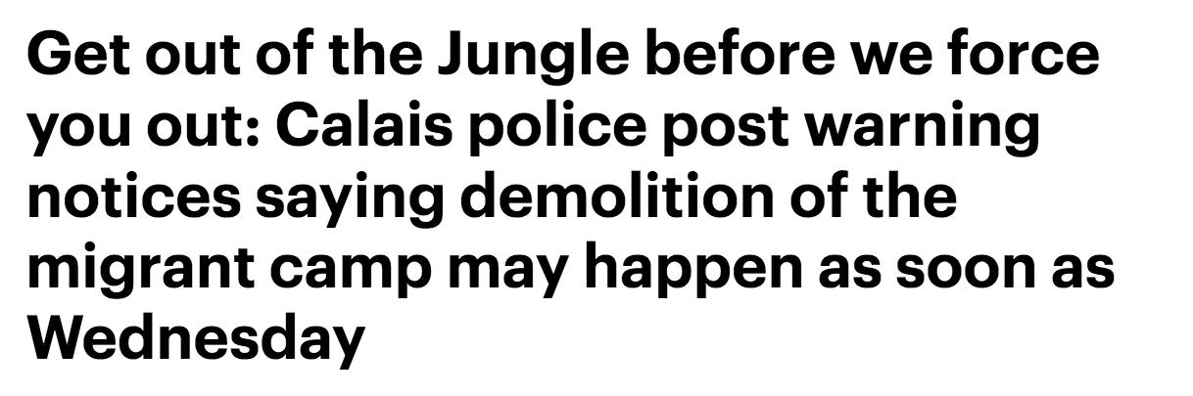
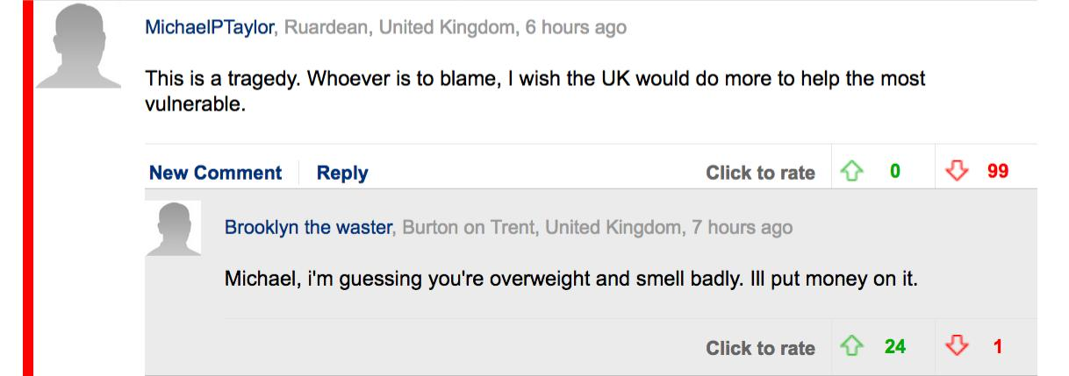
User Research
Some users commend dailymail.co.uk for its captivating content and extensive news coverage, while others condemn it for its sensationalist and biased reporting and use of clickbait headlines.
Many users have concerns about the website's user interface, including congested layouts and excessive information.
Some users criticize the website's comment sections as hotbeds of hate speech and trolling.
The participants in our research included both frequent and infrequent users of the website.

Slide 7
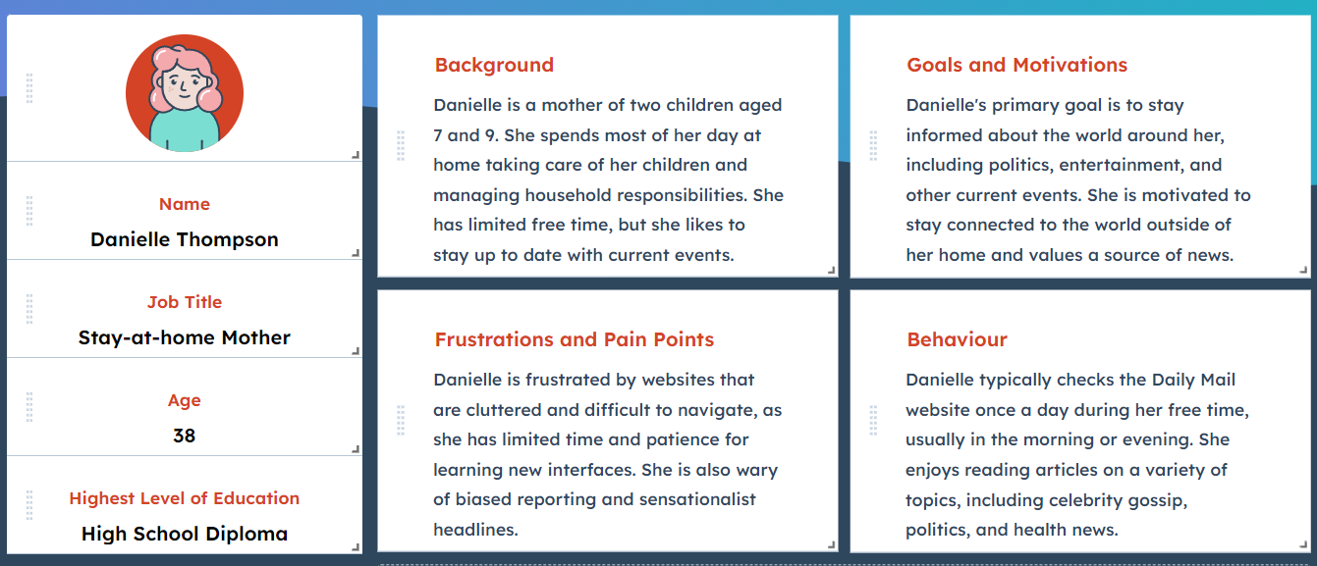
User Persona

Slide 8
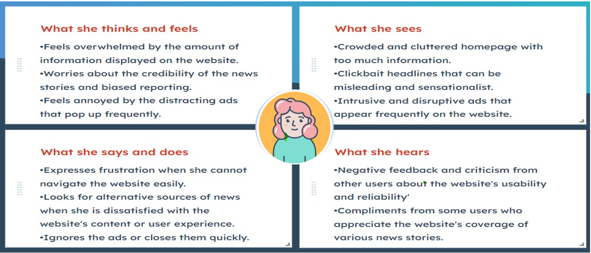

Empathy Map

Slide 9
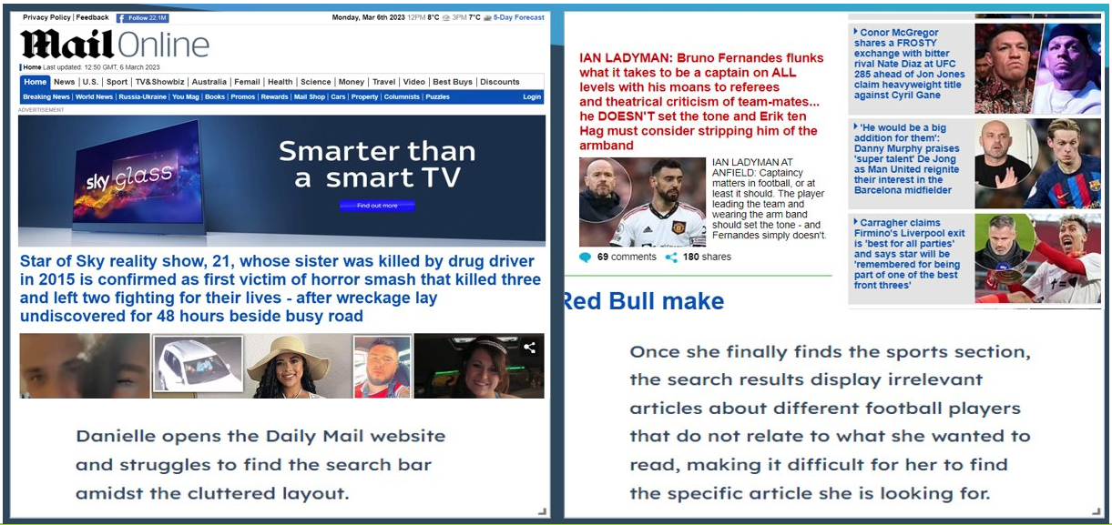
Storyboard “As Is”

Slide 10
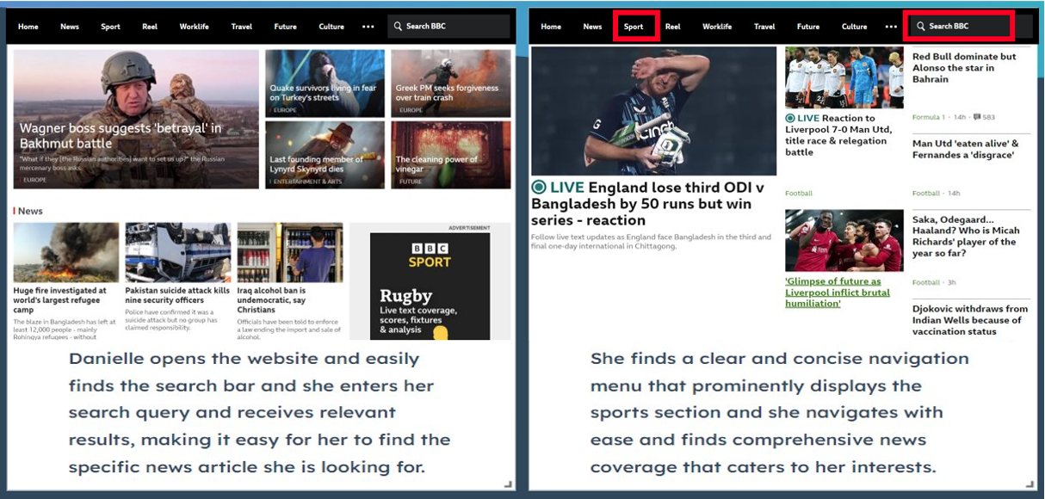
Storyboard “To Be”

Slide 11

Design Ideas
Personalized News Feed
Comment Moderation
Simplified User Interface
Fact-Checking
User Feedback
Notes:
Personalized News Feed: Many news apps such as Flipboard and Google News have implemented a personalized news feed that curates articles based on the user's interests, reading history, and location. This feature can help address the issue of cluttered layouts and overwhelming amounts of information that some Daily Mail users have complained about.
Comment Moderation: Social media platforms such as Facebook and Twitter have implemented robust comment moderation features that use artificial intelligence and human moderators to remove hate speech, trolling, and other inappropriate content. Implementing similar comment moderation features on the Daily Mail website can help address concerns about the website's comment sections.
Simplified User Interface: Some news websites such as BBC News and The Guardian have implemented simplified user interfaces that prioritize readability, ease of use, and accessibility. Simplifying the user interface of the Daily Mail website can help address complaints about cluttered layouts and overwhelming amounts of information.
Fact-Checking: In recent years, there has been an increasing focus on fact-checking and combating fake news. Some news organizations such as The Washington Post and Reuters have implemented fact-checking features that help users verify the accuracy of news articles. Implementing fact-checking features on the Daily Mail website can help address concerns about sensationalist and biased reporting.
User Feedback: Many apps and websites have implemented user feedback features that allow users to rate articles, provide feedback, and suggest improvements. Implementing a user feedback feature on the Daily Mail website can help the organization understand the needs and preferences of its users and make improvements accordingly.

Slide 12
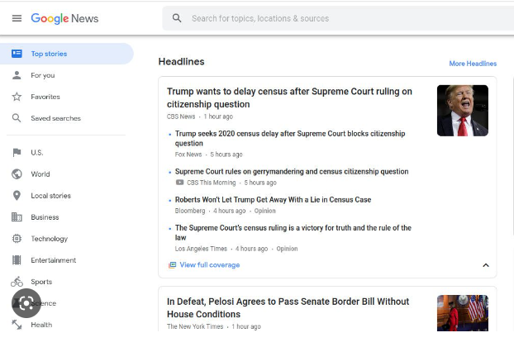
Personalised News Field
The Daily Mail could enhance its news delivery by customizing its news presentation according to the user's typical reading preferences.
Currently, the Daily Mail presents a wide array of different news genres that make it difficult for the user to find the news that they want to read the most.
By gathering the user’s data, it could prioritise the genre of news that the user reads the most, which could lead to a better user experience.
This is commonly used in news sites such as Flipboard and Google News to appeal to the user and keep them engaged. If the Daily Mail were to implement this, it would lead to an improvement in the layout and allow for readers to navigate the website more easily.
In Danielle Thompson’s case, since her primary news interest is sports, the Daily Mail could feature sports news at the top of her 'feed' to help her navigate the site more effectively.

Slide 13
Comment Moderation
One of the main issues with the Daily Mail is the misuse and abuse of its comment section. To tackle this problem, the following measures could be implemented:
The Daily Mail should moderate the comment section more closely. This could involve having a report button for comments that violate their hate speech policy, and having both human and AI moderators who monitor each comment for any violations. This approach is commonly used on social media platforms like Facebook and Twitter.
Headlines should be designed to be less sensationalist and controversial. Extreme headlines tend to attract the most extreme opinions, which can fuel heated and unhealthy discussions in the comment section.
By making the Daily Mail more user-friendly and promoting healthy discussions, readers could also provide feedback on the quality of the articles. This feedback can help the Daily Mail improve the accuracy of its reporting.

Slide 14
Simplified User Interface
When opening the Daily Mail’s website, the user is assaulted with large headlines, white space and differing font lengths that make it very difficult for the user to make out anything.
This is because the website prioritises clickbait headlines over readability that lead to a very complicated user interface.
This is in contrast to the BBC, which uses a simplified user interface that is easier to read and understand for the user.
The Daily Mail could shift to this approach by streamlining the font sizes and getting rid of the white space. It could integrate the ads in the same space as the news articles to address the criticism of excessive ads that is often brought up.
In the case of Danielle Thompson, the easy UI could make her want to read the website more due to it being easier to navigate the website, and less ads that stick out to her.

Slide 15
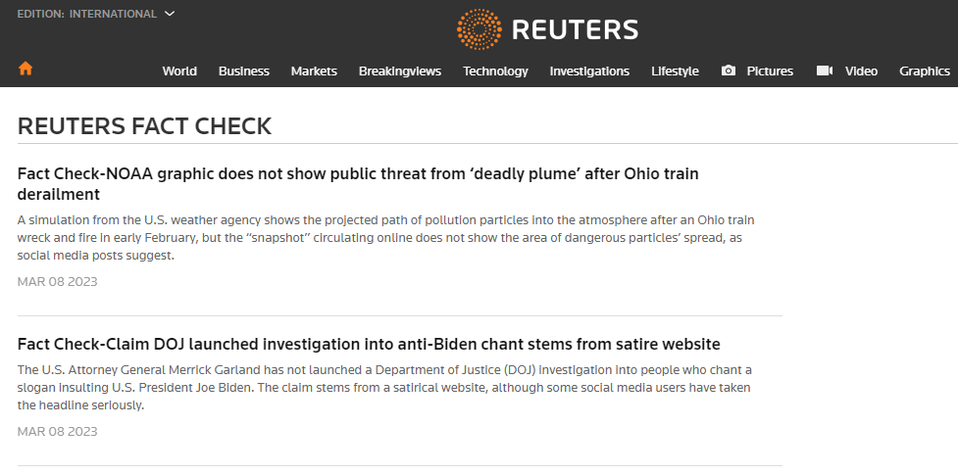
Fact-checking & User Feedback
The Daily Mail has a reputation of having sensationalist headlines, and that translates onto its articles, where there is often a lot of fake news and bad reporting.
It is clear that the Daily Mail takes a quantity-over-quality approach, leading to the articles being very inaccurate and inconsistent in quality.
Prominent media sites such as the Washington Post and Reuters have fact-checking options that allow the users to report any inaccuracies in the articles.
The Daily Mail could utilise this to improve its reputation regarding its reporting and reduce its reliance on sensationalist headlines and clickbait.
In Danielle Thompson’s case, this would make her feel more secure regarding the credibility of the articles and would make her want to browse the site more.

Slide 16
THANK YOU!!!

